Slide 1

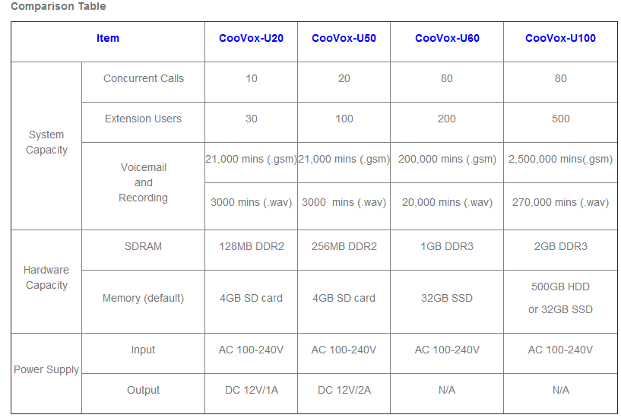
Interface:
2xRJ11 Ports, 1FXO+1FXS
FXOS Module
Special Function:
FXO to FXS Lifeline

Slide 2
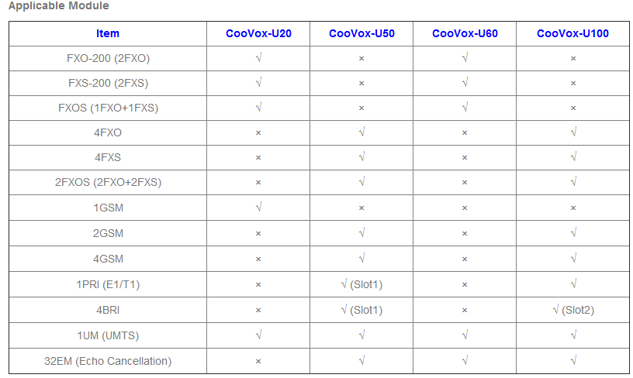
Interface:
2xRJ11 Ports, 1FXO+1FXS
FXOS Module
Special Function:
FXO to FXS Lifeline

Slide 3
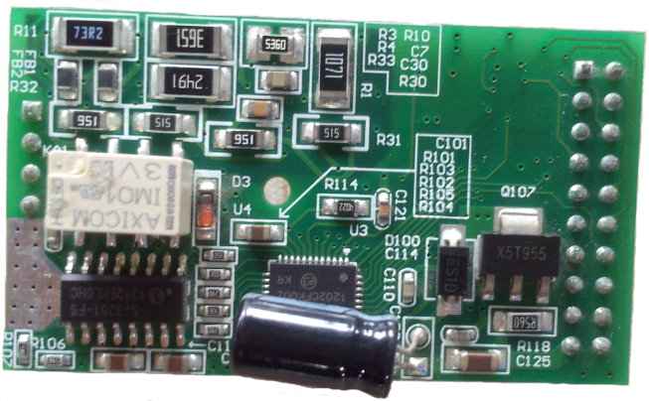
Interface:
2xRJ11 Ports, 1FXO+1FXS
Applicable Models:
U20/U60
FXOS Module
Special Function:
FXO to FXS Lifeline

Slide 4
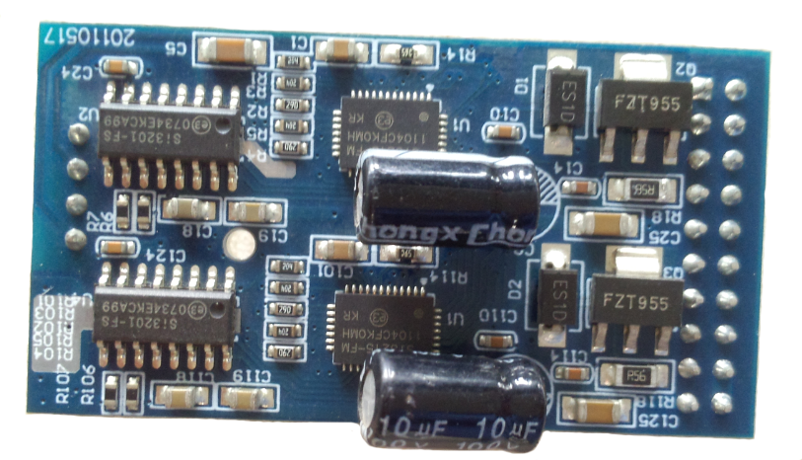
Interfaces:
2xRJ11 FXS Ports
2FXS 模块
Applicable Models:
U20/U60
2FXS Module

Slide 5
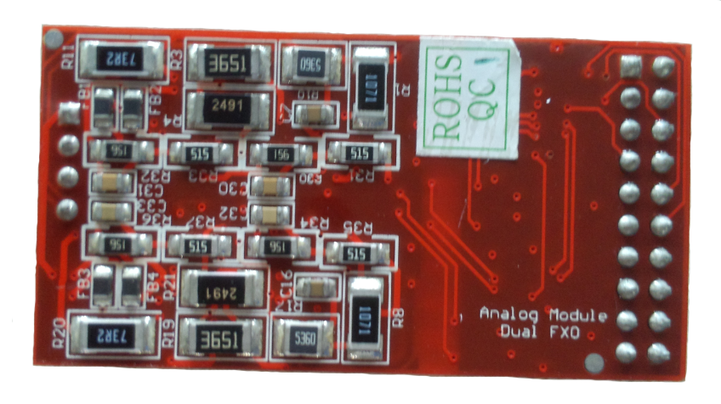
Interfaces:
2xRJ11 FXO Ports
2FXS 模块
Applicable Models:
U20/U60
2FXO Module

Slide 6
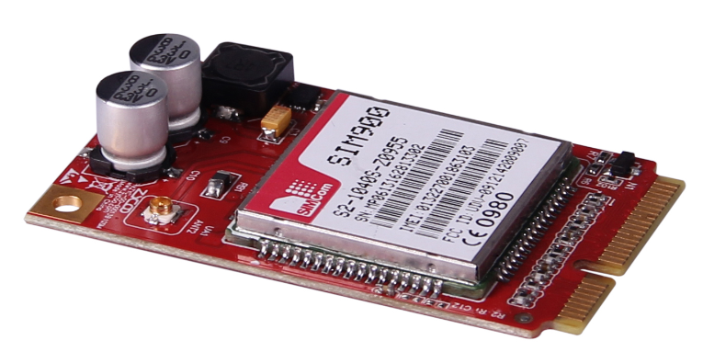
Working Frequencies：
GSM/GPRS
850/900/1800/1900MHz
Applicable Models：
U20
1GSM Module

Slide 7
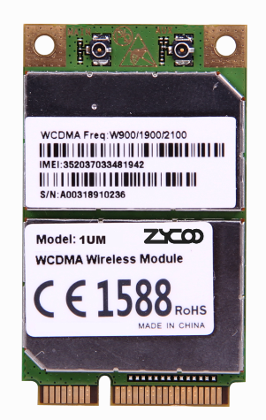
Working Frequencies：
WCDMA
900/1900/2100MHz
Applicable Models：
IPPBX(U20/U50/U60/U100)
X-Router(UC510/UC520)
3G/UMTS Module

Slide 8
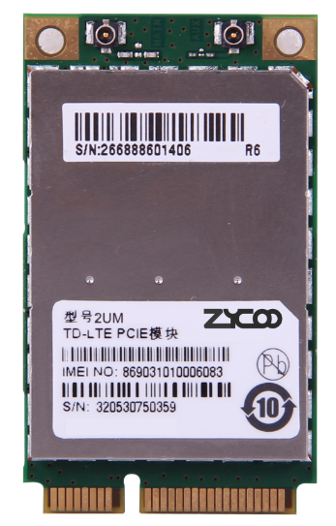
Operating Frequency：
LTE TDD 1.9/2.3/2.6GHz
LTE FDD 2.6GHz
TD-SCDMA 1.9/2.1GHz
Applicable models :
IPPBX(U20/U50/U60/U100)
X-Router(UC520)
4G Module

Slide 9
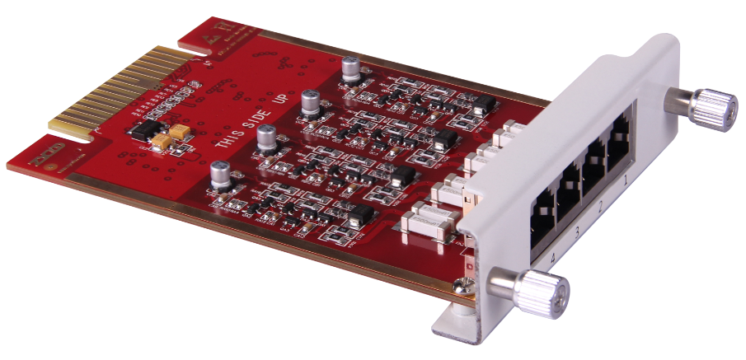
Interface：
4xRJ11 FXO Interfaces for PSTN
Applicable Models：
U50/U100(Slot1&Slot2)
4FXO Module

Slide 10
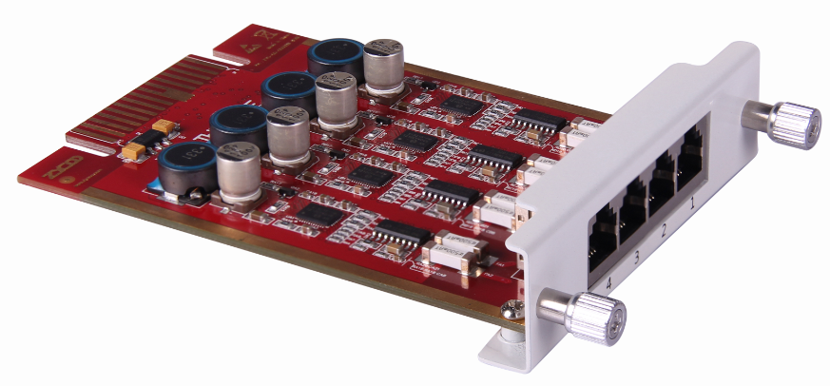
Interface：
4xRJ11 FXS Ports for Analog extension or fax machine
Applicable Models：
U50/U100(Slot1&Slot2)
4FXS Module

Slide 11
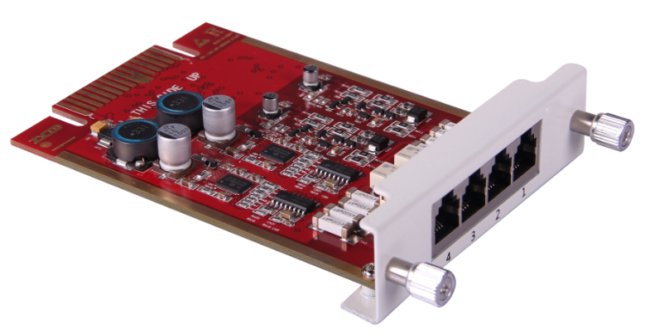
Interface：
2xRJ11 FXO Ports
2xRJ11 FXS Ports
Applicable Models：
U50/U100(Slot1&Slot2)
2FXOS Module
Special Function：
FXO to FXS Lifeline

Slide 12
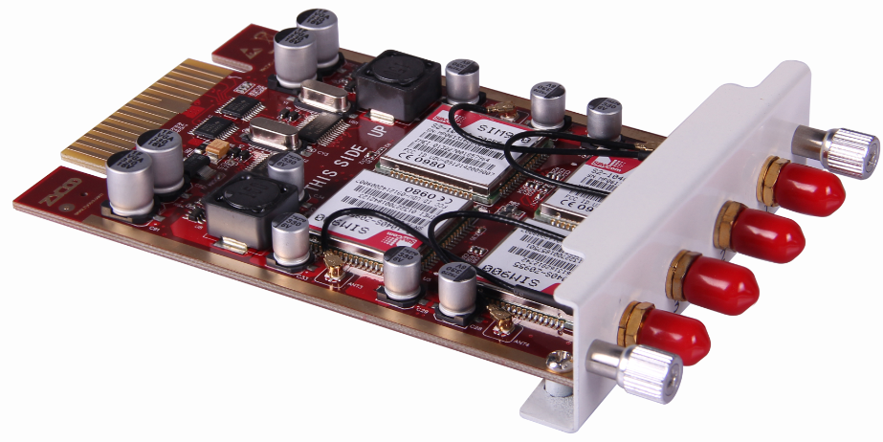
Interface：
4xGSM Ports
Working Frequencies：
GSM/GPRS
850/900/1800/1900MHz
4GSM Module
Applicable Models ：
U50/U100(Slot1&Slot2)

Slide 13
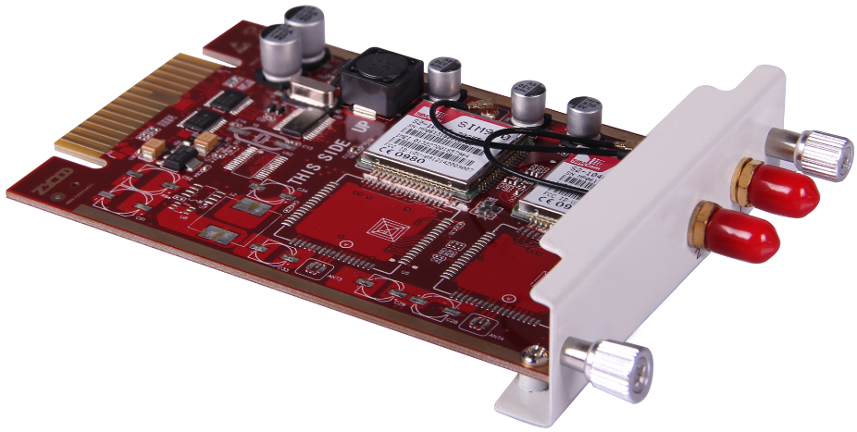
Interface：
2xGSM Ports
Working Frequencies：
GSM/GPRS
850/900/1800/1900MHz
Applicable Models：
U50/U100(Slot1&Slot2)
2GSM Module

Slide 14
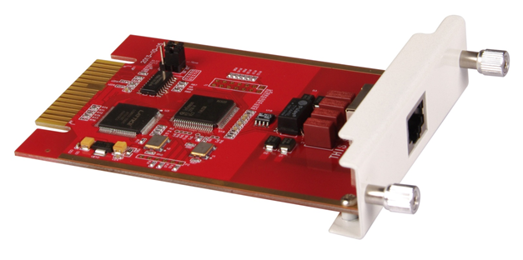
Interface：
E1 PRI or T1 Digital Trunk Interface(RJ45)
Applicable Models：
U50(Slot1，Jumper Position Master)
U100(Slot1 & Slot2，Jumper Position Slave)
E1/T1 Module

Slide 15
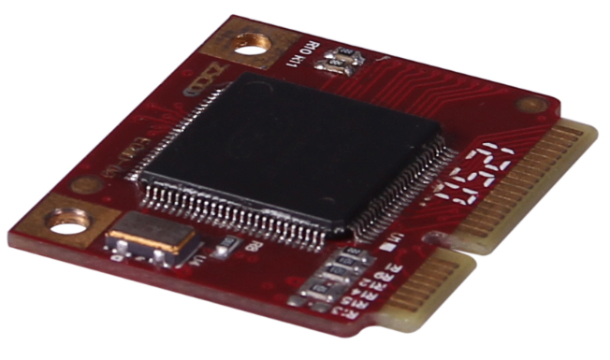
Capacity：
32 Channels
Applicable Models：
U50(1 EC Slot)
U60(1 EC Slot)
U100(2 EC Slots)
32EM Module

Slide 16
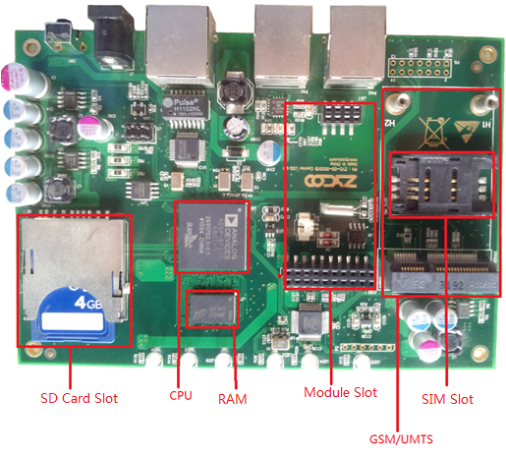
U20 Main Board
Specification:
500MHz Blackfin BF609 DSP
128MB RAM
4GB SD Card(32GB Maximum)
Dual-Channel Module Slot
GSM/3G Module Slot
SIM Card Slot

Slide 17
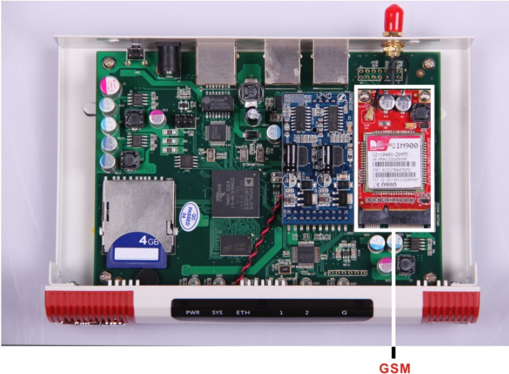
U20 Inner Structure 1
Configuration:
2FXS+1GSM

Slide 18
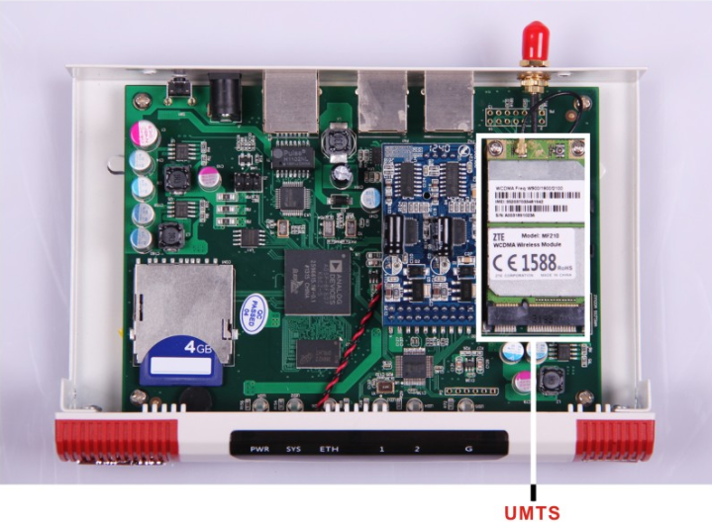
U20 Inner Structure 2
Configuration:
2FXS+UMTS

Slide 19
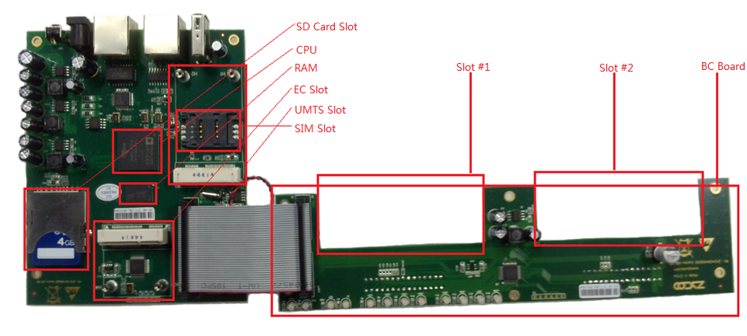
Specification: 500MHz Blackfin BF609 DSP, 256MB RAM, 4GB SD Card(32GB Maximum), UMTS Slot, SIM Slot, EC Slot, 2-Slot BC Board
U50 Main Board

Slide 20
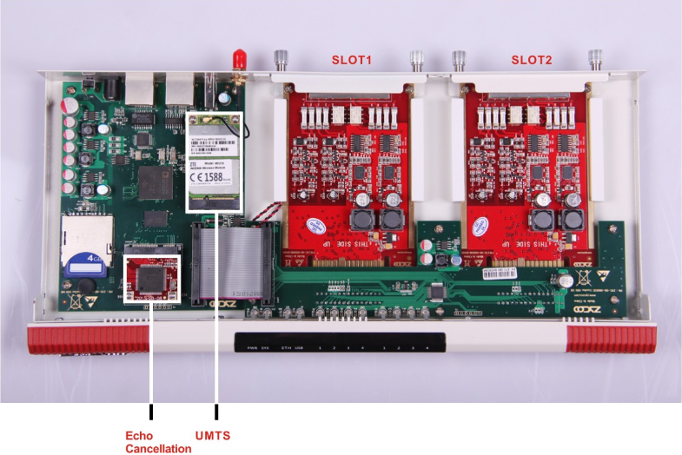
U50 Inner Structure
Configuration:
2FXOS+2FXOS
EC+UMTS

Slide 21
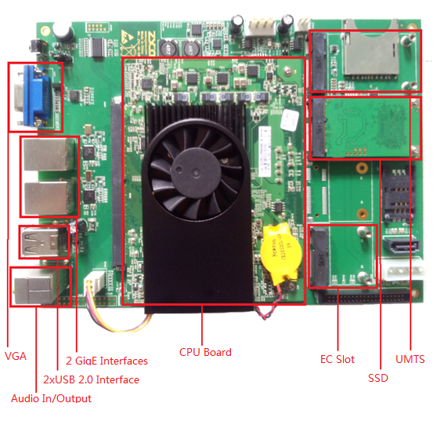
U60 Main Board
Configuration:
Atom D2550 1.86GHz Dual-Processor CPU
1GB DDRIII RAM
16GB SSD
UMTS Slot
1xEC Module Slot
2xUSB 2.0 Interfaces
2x GigE Interfaces
Audio In/Output
VGA Interface

Slide 22
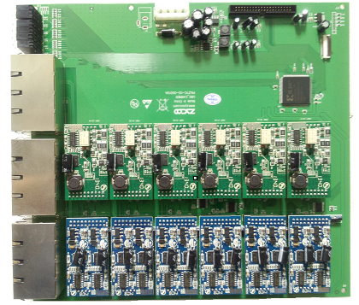
U60 BC Board
Specification:
12xDual-Channel Module Slots
24xRJ11 Ports
24xLED

Slide 23
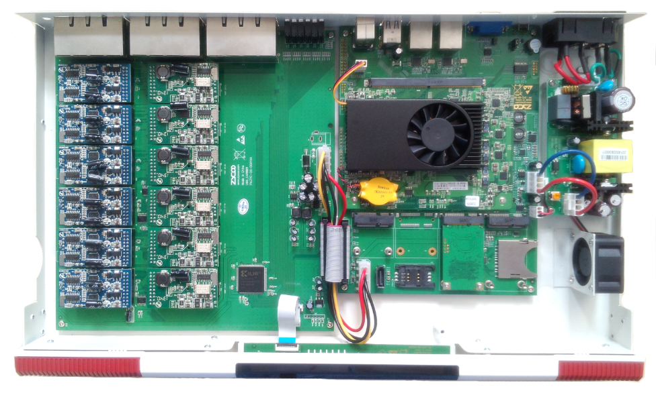
U60 Inner Structure
Configuration:
6xFXOS Modules
6x2FXS Modules

Slide 24
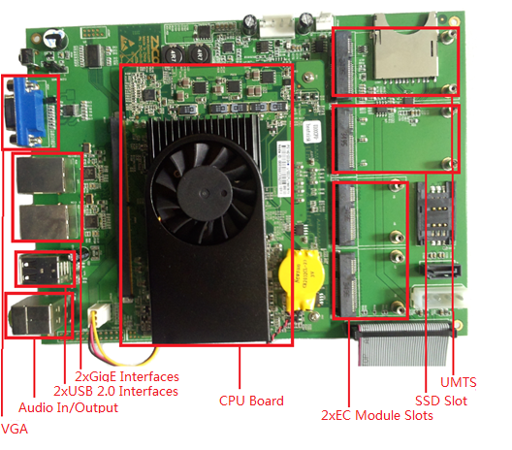
U100 Main Board
Configuration:
Atom D2550 1.86GHz Dual-Processor CPU
2GB DDRIII RAM
SSD Slot(SSD Optional)
UMTS Slot
2xEC Module Slot
2xUSB 2.0 Interfaces
2x GigE Interfaces
Audio In/Output
VGA Interface
SATA Interface

Slide 25
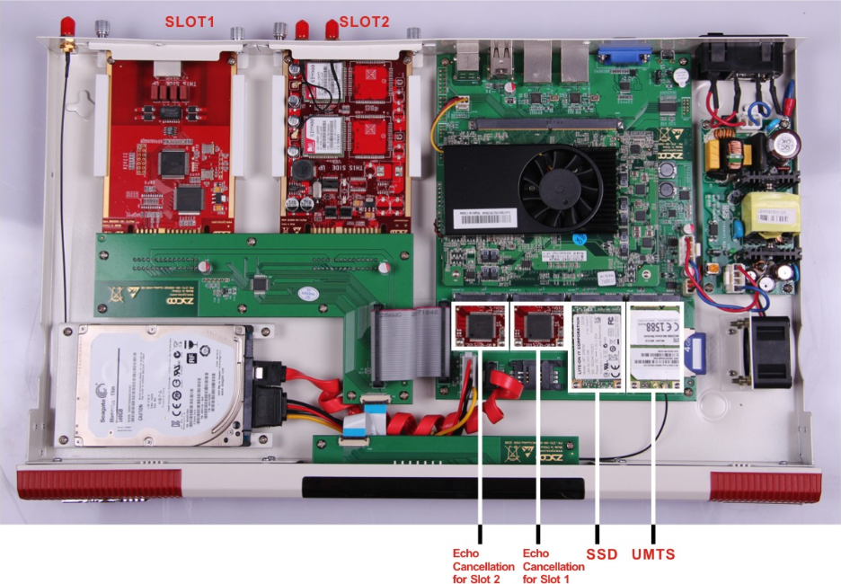
U100 Inner Structure
Configuration:
E1/T1+2GSM
16GB SSD
UMTS
2xEC Modules
500GB Hard Drive

Slide 26
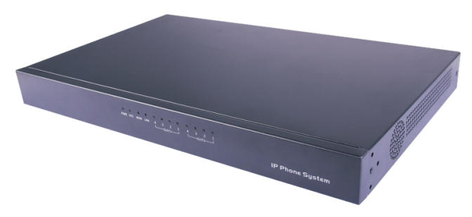
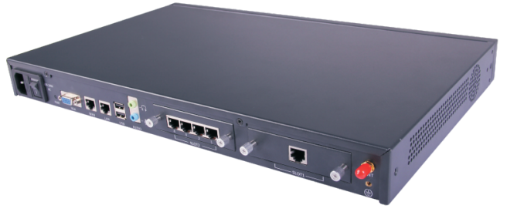
Asterisk P2 Platform

