Slide 1
KX-HTS Step by Step Guide
Basic Call
August 4, 2016
Panasonic System Networks
PBX SE team
Specifications are subject to change without notice.

Slide 2

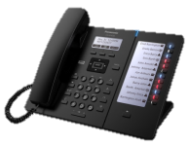
1. Overview
This document explains programming for following example.
1. Incoming call
from CO-1 to Extension 101
from CO-2 to Group (101 + 102)
from CO-3 to DISA AA and dial 1 to Group
AA : Automated Attendant
“Hello this is Panasonic Travel,
dial 1 to book Niseko Snow hotel,
dial 2 to.. .”
2. TRS (Toll Restriction) for outgoing call
PSTN
012- 345- 6789
KX-HTS
101 102 103
Dial 9-012-345-6789
Notes:
2

Slide 3
2. Table of Contents
Chapter | Contents
1 | Incoming Call : DIL / Group / DISA
2 | Outgoing Call : TRS
Notes:
3

Slide 4
Chapter 1
Incoming Call

Slide 5
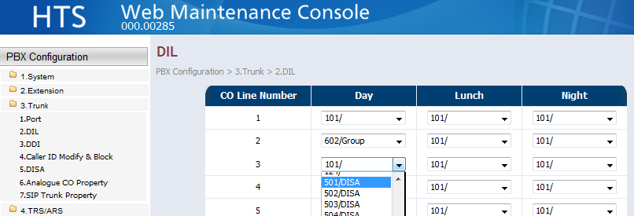
11. DIL
Select “101” for CO-1.
Select “602:Group” for CO-2.
Select “501:DISA” for CO-3.
Different destination can be programmed for time service.
Notes:
5

Slide 6
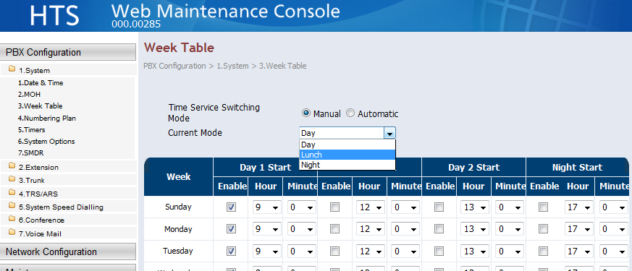
12. Week Table
Time service can be switched automatically using week table
or manually.
Current time service can be confirmed and switched by Web-MC.
Notes:
6

Slide 7
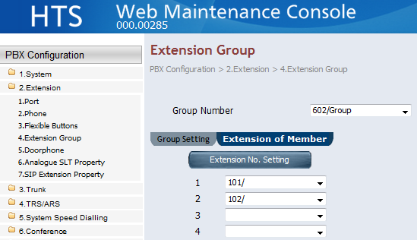
13. Extension Group - Member
Select “101” and “102” as member for group “602”.
Notes:
7

Slide 8
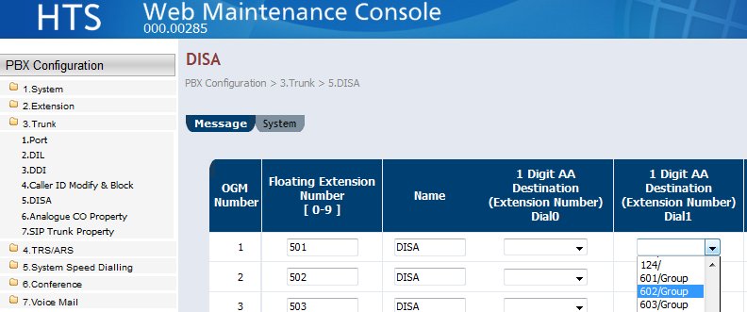
14. DISA
Select “602” for AA-1 of DISA501.
Notes:
8

Slide 9
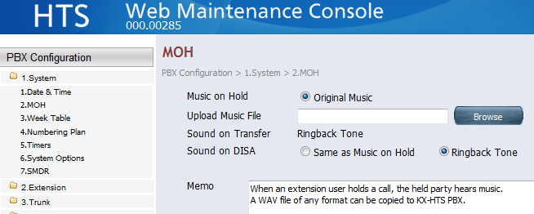
15. Music on Hold for DISA
Sending Music or Ring-back tone can be selected for DISA call.
Notes:
9

Slide 10
16. Record DISA
Manager extension can record a DISA greeting.
Extension 101 and 103 are Manager by default.
<IP Phone>
Dial *36 1(Recording) + 501 + Off hook.
After confirmation tone, you can start recording.
“Hello this is Panasonic Travel….”
To end record, dial #.
To delete : *36 0 + 501 + Off hook
To listen : *36 2 + 501 + Off hook
Notes:
10

Slide 11
17. Test
Call CO 1 to 3 from PSTN.
CO-1 to Extension 101
CO-2 to Group (101 + 102)
CO-3 to DISA AA
PSTN
012- 345- 6789
KX-HTS
101 102 103
Dial 9-012-345-6789
Notes:
11

Slide 12
Chapter 2
Outgoing Call

Slide 13
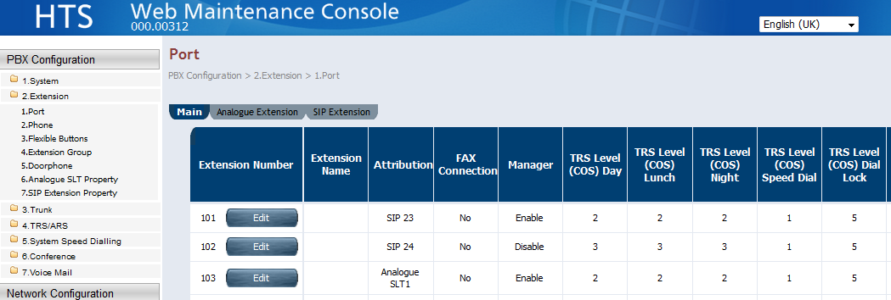
21. TRS level for Extension
TRS level can be programmed for each extension and time service.
For example, 101 for level 2 and 102 for level 3.
Notes:
13

Slide 14
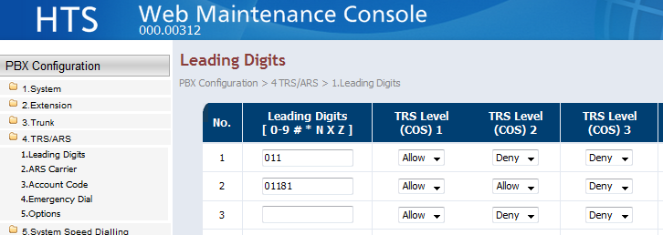
22. Leading Digits
Allow and deny can be programmed for dial.
Phone number of pubic telephone network has to be programmed.
If programming is as follows,
9/0-011-xxxxxxxxxxx except 9/0-011-81-xxxxxxxx is restricted for TRS level 2.
9/0-011-xxxxxxxxxxx including 9/0-011-81-xxxxxxxx is restricted for TRS level 3.
011 is international access code from Canada. 81 is country code of Japan.
Notes:
14

Slide 15
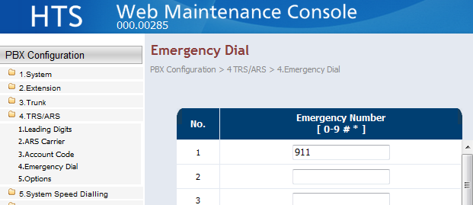
23. Emergency Dial
Emergency dial overrides TRS (Restriction).
911 is to call police in Canada.
Notes:
15

Slide 16
Thank you !

Slide 17
Revision
Date | No. | Change
June 30, 2015 | All | First draft
July 23, 2015 | All | 2nd draft
July 28, 2016 | All | GUI was revised.
 | All | First official release
August 4 | 16 (Page 10) | Explanation was revised.
 | Chapter 2 | Explanation was revised.
Notes:
17

