Slide 1
KX-HTS Step by Step Guide
Initial Set-up
September 1, 2016
Panasonic System Networks
PBX SE team
Specifications are subject to change without notice.

Slide 2





1. Very Easy Installation
KX-HTS can be installed very easily.
Only Plug and Play are required for basic use.
Basic settings are programmed automatically after initialize.
- All extension users can make a call to analog CO.
- All extension users can receive a call from analog CO.
Plug and Play even for KX-HDV SIP phone !
< Easy Cabling >
2 RJ45 jacks for 2 KX-HDV phones
…..
T : Tip
R : Ring
KX-HTS
Each RJ11 jack
for each CO or SLT port
101 102 103 104 …. 124
PoE is not supported.
L2-switch is required for 3 or more SIP phones.
SLT = Analog Single Line Telephone
Notes:
2

Slide 3
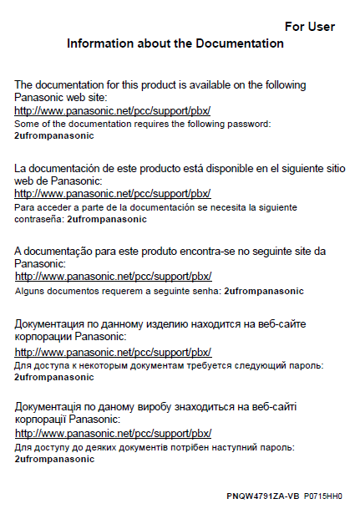
2. Manual (PDF) and Software
Manual (PDF) and latest software for this product are
available on the following Panasonic web site:
http://www.panasonic.net/pcc/support/pbx/
Some of the documentation requires the
following password :
2ufrompanasonic
Leaflet is packed in KX-HTS for this information.
This document (Step by step guide) explains
summary only.
It is important to read manuals and leaflet before selling and installing this product.
Notes:
3

Slide 4
3. Software Version
Software of KX-HTS, KX-HDV and KX-NTV has to be latest.
KX-HTS version 1.5 supports followings.
(1) Phone book on LCD of KX-HDV by PBX system speed dial
(2) CO button of KX-HDV230
(3) Conference by SLT
Software version up of KX-HDV phone is also required for (1) and (2).
Software of KX-NTV has to be version 0101e or later.
If software version is 0101d (first mass production version), KX-NTV cannot be connected to KX-HTS.
(KX-NTV first version can be connected to KX-NS/NSX only.)
KX-HDV except KX-HDV230 does not support CO button.
Notes:
4

Slide 5
4. Table of Contents
Chapter | Contents
1 | Installation and Initialize
2 | Web Maintenance Console
3 | Phone Connection
4 | CO Line Connection
5 | IP Configuration : LAN / Wireless LAN / WAN
Notes:
5

Slide 6
Chapter 1
Installation & Initialize

Slide 7
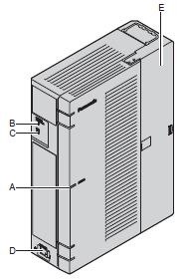
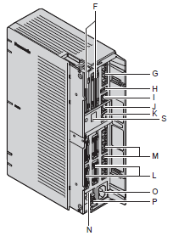
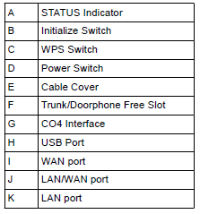
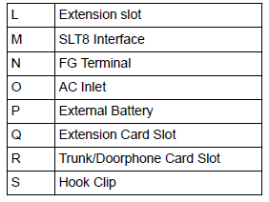
11. Appearance
Notes:
7

Slide 8
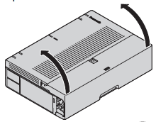
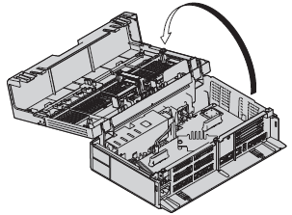
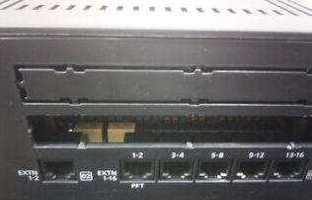

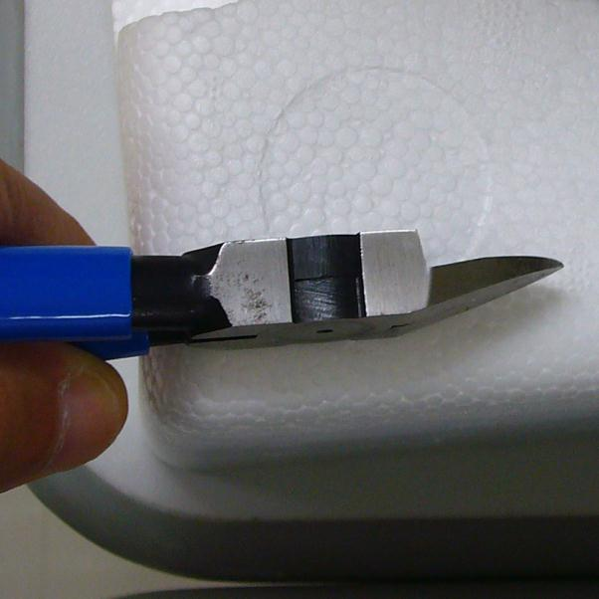
12. Card Installation
Optional card has to be installed during power-off.
1. Power Off.
2. Remove AC cable and open a cover.
3. Install required cards to KX-HTS.
Do not turn on power when a cover is opening.
Remove blank panel perfectly.
Otherwise optional card cannot be installed.
Do not use a knife. Installer may be injured.
Use a nipper.
More than 1 cm
This is not OK.
(This picture is not KX-HTS.)
Notes:
8

Slide 9
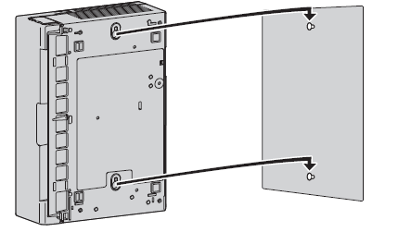
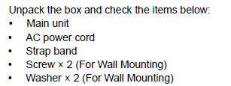
13. Wall Mounting
Install KX-HTS on wall.
KX-HTS supports router with Wireless LAN function.
Notes:
9

Slide 10
14. Initialize
KX-HTS PBX has to be initialized at first before programming.
Operation and System LED (A) are as follows.
1. Keep pressing Initialize button (B).
2. Power On (D).
(a) Amber On : 4 sec
(b) Amber rapid flash starts.
(c) Green rapid flash starts.
3. During (c), release Initialize button.
(d) Green rapid flash : 60 sec
4 flash / sec
=> After system is initialized, system LED
becomes green on.
If only power on, green slow flash starts after (a).
It takes for 60 sec. 1 flash / sec
Notes:
10

Slide 11
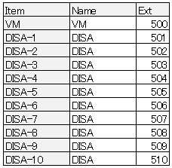
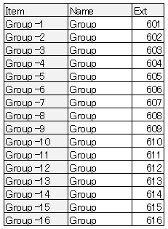
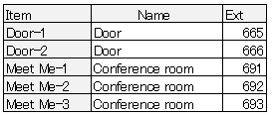
15. Default Data
Basic settings are programmed automatically after initialize.
- All extension users can make a call to analog CO.
- All extension users can receive a call from analog CO.
<Default of Floating Extension Number & Name>
Notes:
11

Slide 12
Chapter 2
Web-MC

Slide 13
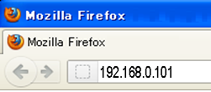



21. Connect PC.
Connect PC to LAN port of KX-HTS.
IP address of PC is provided automatically by KX-HTS, if PC is DHCP client.
DHCP server function of KX-HTS is enabled by default.
Access to 192.168.0.101 from PC using web.
Web application should be one of following.
- Internet Explorer 9-11
- Firefox
- Chrome
Smart-phone and Tablet are not recommended.
Notes:
13

Slide 14
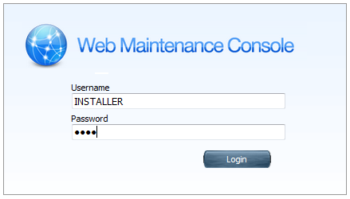
22. Log-in.
Username : INSTALLER
Password : 1234
Click [Login]
Notes:
14

Slide 15
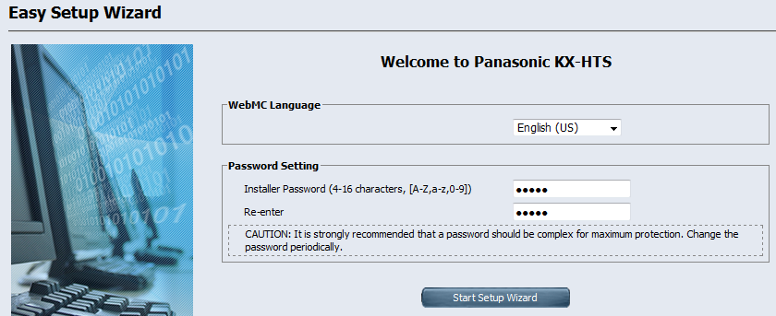
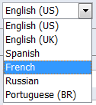
23. Start Easy Set-up.
1. Select language.
2. Select location. This selection is not required and not displayed usually.
3. Change password from “1234”.
4. Click [Start Setup Wizard].
Notes:
15

Slide 16
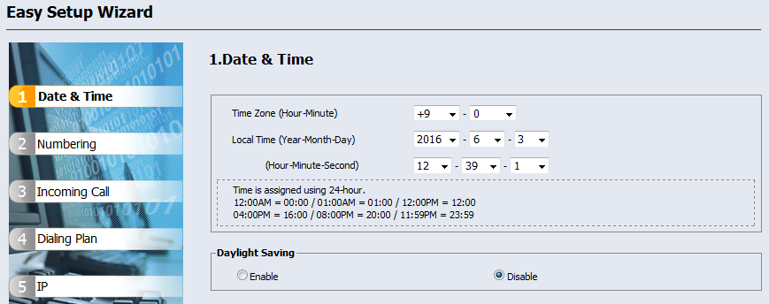
24-1. Step 1
1. Select correct time zone and time.
2. Click [Next].
If time zone is incorrect, e-mail may not be sent correctly.
Notes:
16

Slide 17

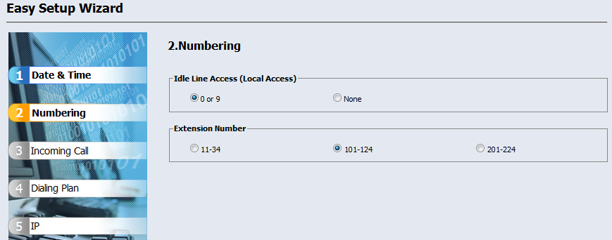
24-2. Step 2
1. Select parameter. (Default is OK.)
2. Click [Next].
When “None” is selected for Local Access, “0” or “9” is not required to call trunk. This also can be effective by full programing mode later.
Notes:
17

Slide 18
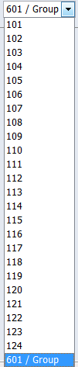
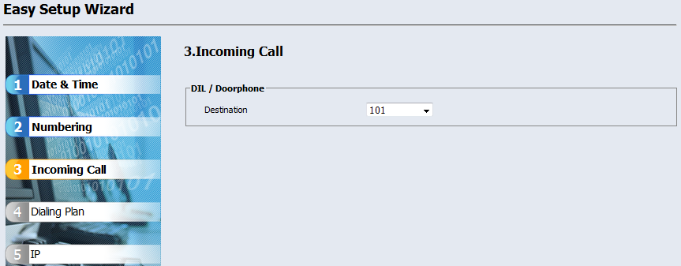
24-3. Step 3
1. Select parameter. (Default is OK.)
2. Click [Next].
Notes:
18

Slide 19
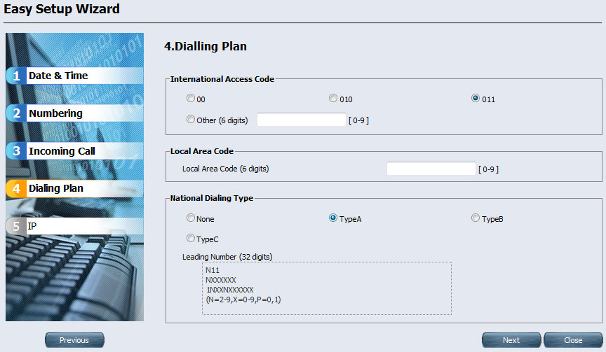
24-4. Step 4
1. Select international access code to restrict calling by TRS.
2. Dialing type is for USA. (Default is OK for other area.)
3. Click [Next].
Dialing plan of PSTN in USA is very complicated.
TRS = Toll Restriction / Call Barring
Notes:
19

Slide 20
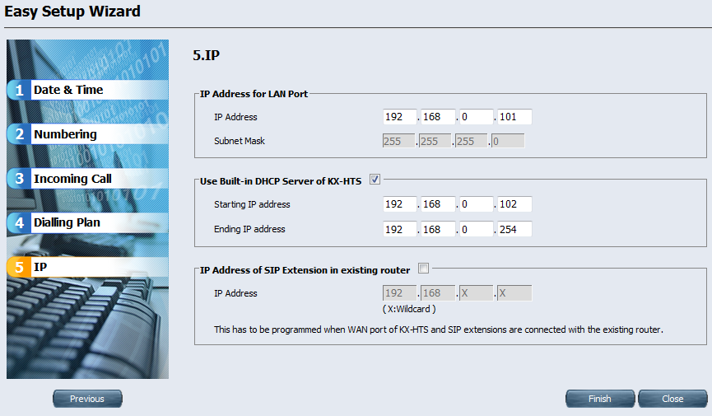
24-5. Step 5
1. Click [Finish]. (Default is OK.)
Notes:
20

Slide 21
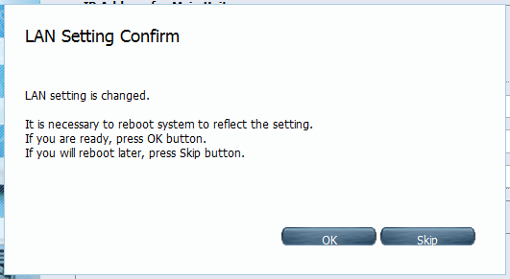
25. Finish Easy Set-up.
1. Click [Skip] to continue programming.
Notes:
21

Slide 22
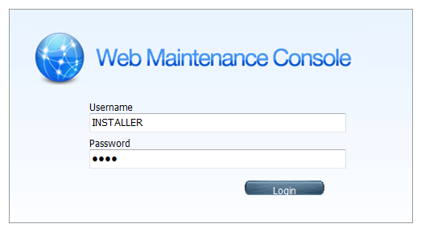
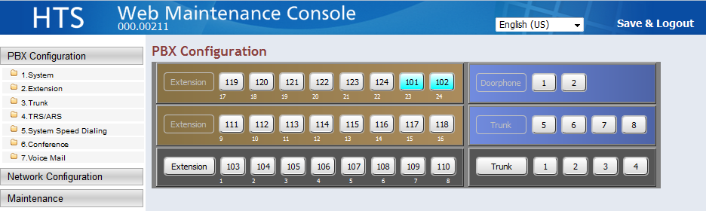
26. Web-MC Full Programming
Easy Set-up is available only one time after initialize.
Full programming mode is available from next connection.
If software of KX-HTS is not latest, it is important to upgrade software to latest version now after Easy Set-up.
See step by step guide No.9 for details.
It is better to initialize and do Easy Set-up again after version up just in case for new installation.
Notes:
22

Slide 23
Chapter 3
Phone Connection

Slide 24

31. Connect Phones.
Total 24 KX-HDV phone and Analog SLT phone can be connected automatically without any programming.
- SIP phone registration is required manually for other SIP phone including KX-NTV.
- Extension 101 and 102 are for KX-HDV. 103 to 124 are for SLT.
- If more than 2 KX-HDV phones are connected, L2 Switch is required and
larger extension number is used for KX-HDV automatically instead of SLT.
SLT port of the extension does not work.
KX-HTS
KX-HTS
L2 Switch
LAN
101 102 103 104 …. 124
Analog line
LAN cable
103 104 …. 122
101 102 124 123
For example, 4 KX-HDV phones and 8 SLT phones can be connected without
optional 8-port SLT card. Virtual card installation (like KX-NS) is also not required.
Notes:
24

Slide 25
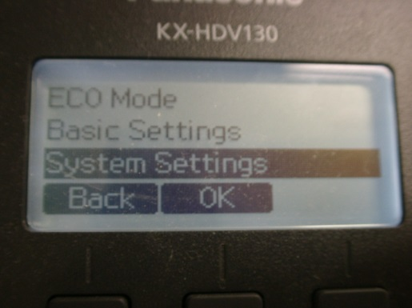
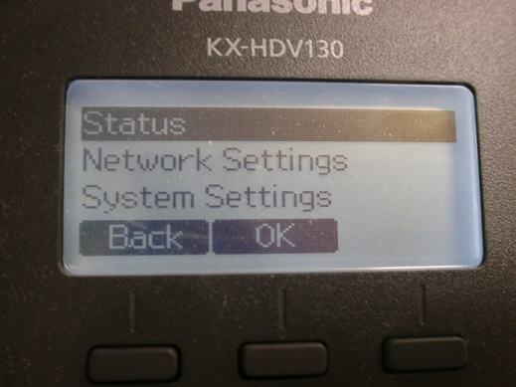
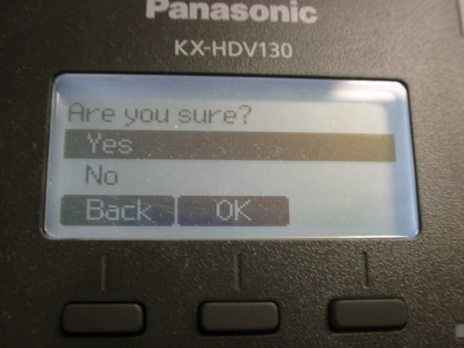
32. Initialize KX-HDV Phone.
If KX-HDV phone has been already registered to other SIP server or SIP carrier, it is required to initialize it in order to connect to KX-HTS.
1. Select “System Settings”. 2. Dial #136. 3. Select “Yes”.
Notes:
25

Slide 26
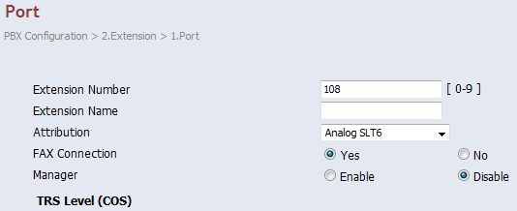


33. Connect Fax.
Fax has to be enabled for analog SLT port by programming.
Fax data transmission does not work by default.
<Apply> is required for
any programming.
T.38 is not supported for SIP trunk and SIP extension.
G.711 and analog line are available for fax.
4 analog trunks (CO) and 8 analog extensions (SLT) are pre-installed by factory.
Notes:
26

Slide 27
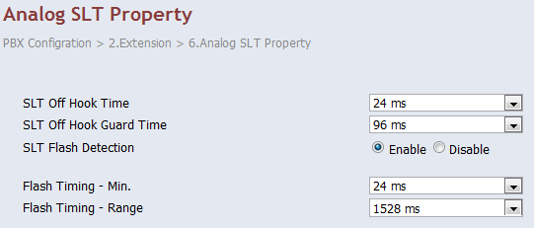
34. Adjust Flash Time of SLT.
Flash from analog SLT phone has to be adjusted.
On-hook roughly after talking becomes “Flash” sometimes.
This becomes cause of unexpected transferring or holding a analog CO.
This can be reduced by programming for range of Flash.
If the extension talked with other extension or SIP trunk, call is disconnected automatically because KX-HTS can detect disconnect from other party.
504ms (Min) and
208ms (Range)
if Flash of SLT in your market is 600ms for example.
Hold recall starts immediately after Flash + On-hook.
If PBX is other Panasonic KX PBX and SLT flash mode is 1, hold recall starts after 60 seconds as “Ghost call”.
Notes:
27

Slide 28
Chapter 4
CO Line Connection

Slide 29
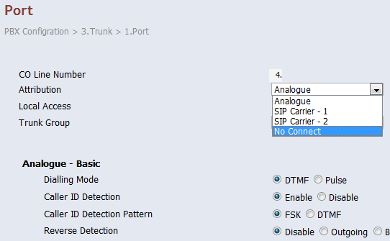
41. Disable unused Analog CO.
Unused analog CO port has to be disabled. Select “No Connect”.
When unused analog CO is selected automatically by Local Access operation (9/0), user cannot call through PSTN.
PSTN
012- 345- 6789
KX-HTS
101 103
Dial 9/0-012- 345- 6789
PSTN = Public Switched Telephone Network
Notes:
29

Slide 30
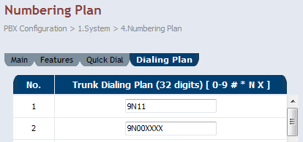
42. Assign PSTN Dialing Plan.
Dialing plan for Analog CO and SIP trunk has to be programmed for SLT user. SLT user has to wait for 10 seconds (default) after dialing all digits without this programming.
Local access number (9/0) has to be added.
If dialing does not match with any entries, time-out
is applied.
PSTN
012- 345- 6789
KX-HTS
101 103
Dial 9/0-012- 345- 6789
and wait for 10 seconds.
Notes:
30

Slide 31
43. PSTN Dialing Plan - Condition
SIP phone including KX-HDV can call without waiting and without programming, if operation is dialing at first and off-hook like operation of cellular phone.
This programming in the previous page is applied to KX-HDV also for operation : Off-hook and dialing.
Dialing plan for following features are assigned automatically for SLT and KX-HDV.
Extension call / Paging call / Call pick up
Call Park / Speed Dial
If ARS is used, this programming in previous page is applied to dial before ARS modification.
Notes:
31

Slide 32
44. Connect Analog CO and Confirm it.
Analog CO connection can be confirmed by calling PSTN using KX-HDV phone or analog SLT phone actually.
When CO button of KX-HDV is pressed, dial tone is made by KX-HDV virtually. (No dial tone from PSTN.)
<KX-HDV>
Dial 80 + CO number (1-8) + PSTN
telephone number and Off hook.
=> Call starts.
<SLT>
Off hook and Dial 80 + CO number (1-8)
+ PSTN telephone number.
=> Call starts after 10s.
PSTN
012- 345- 6789
KX-HTS
101 103
Dial 803-012- 345- 6789
and off hook.
Notes:
32

Slide 33
Chapter 5
IP Configuration

Slide 34




50. LAN / Wireless LAN / WAN
KX-HTS works as router with PBX.
Internet
PSTN
WAN
L2 Switch
LAN
Internet
KX-HTS
Notes:
34

Slide 35
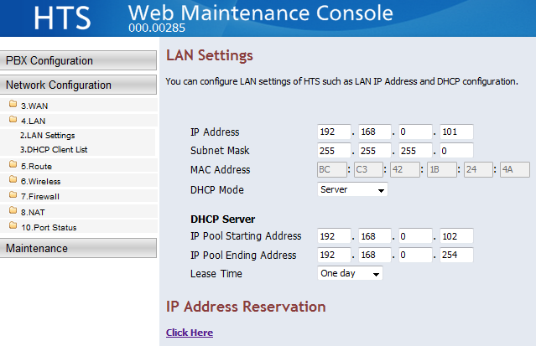
51. LAN
IP address of IP terminal on LAN of KX-HTS is assigned automatically because KX-HTS supports DHCP server by default.
Notes:
35

Slide 36
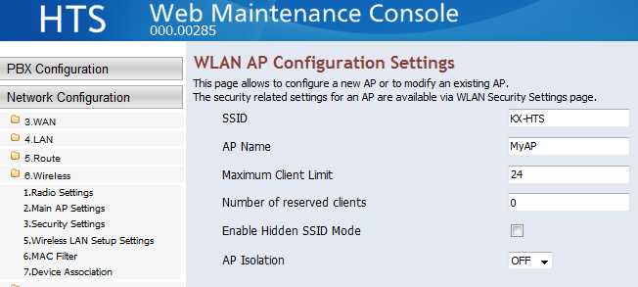
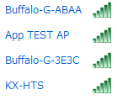
52. Wireless LAN : SSID
SSID and Security Key have to be programmed using Web-MC to connect PC, tablet, smart-phone and so on using Wireless LAN.
Default of SSID is “KX-HTS”.
Notes:
36

Slide 37
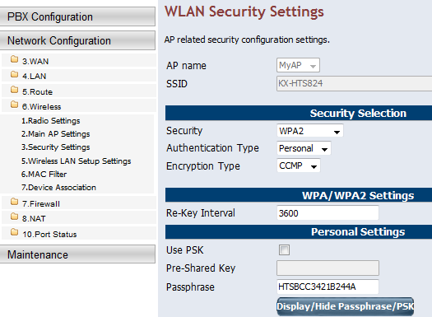
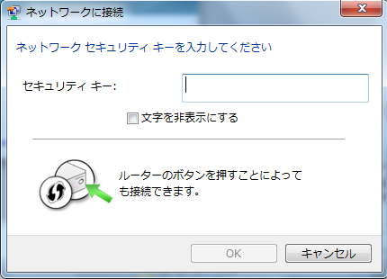
53. Wireless LAN : Security Key
SSID and Security Key have to be programmed using Web-MC to connect PC, tablet, smart-phone and so on using Wireless LAN.
Security key is not common by default to prevent from unexpected access.
Security Key :
Connection is also available using this button of router.
Notes:
37

Slide 38
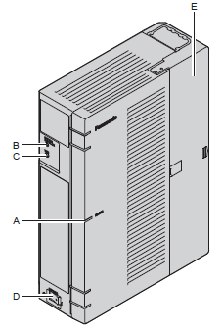
54. Wireless LAN : Setup button
If PC has to be connected to Wireless LAN for Easy Set-up after initialize, it can be connected by Setup button without security key.
1. Select “KX-HTS” as SSID by PC.
2. Press this button of KX-HTS.
(C) is the button.
Security Key :
Connection is also available using this button of router.
Notes:
38

Slide 39
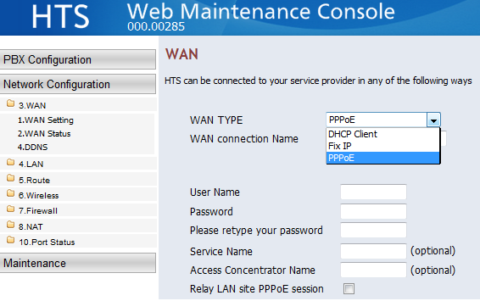
55. WAN for Internet
WAN port can be connected to internet by PPPoE usually.
Ask User Name and Password to your internet provider.
YouTube etc
Internet
KX-HTS
Notes:
39

Slide 40


56. Connection to LAN of Existing Router
WAN port of KX-HTS has to be connected to LAN of existing router as DHCP client or using fixed IP address.
Internet
PSTN
WAN
Existing
Router
LAN:192.168.22.xxx
Office
WAN
192.168.22.99
for example
SIP
Software phone
L2 Switch
LAN : 192.168.0.xxx
KX-HTS
Notes:
40

Slide 41
57. LAN of Existing Router - Condition
When same IP address is used for LAN of KX-HTS and LAN of existing router, LAN of KX-HTS does not work correctly.
Program different segment of IP address to LAN of KX-HTS.
Internet
WAN
Existing
Router
LAN : 192.168.0.xxx
WAN : 192.168.0.99
L2 Switch
LAN : 192.168.0.xxx
to 192.168.11.xxx
Dealer does not need to discuss with IP network administrator of existing router about IP address of each IP phone because segment is different.
KX-HTS
192.168.0.101
to 192.168.11.101
Notes:
41

Slide 42
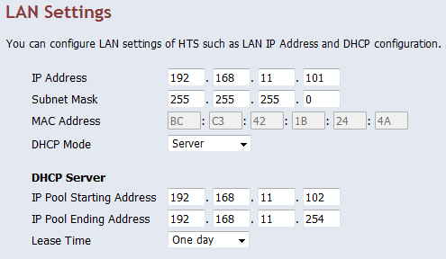
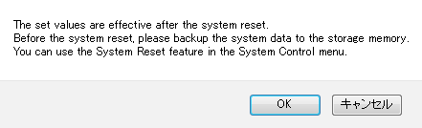
58. Change IP address of LAN.
WAN : 192.168.0.99
L2 Switch
LAN : 192.168.0.xxx
to 192.168.11.xxx
KX-HTS
192.168.0.101
to 192.168.11.101
Notes:
42

Slide 43
Thank you !

Slide 44
Revision
Date | No. | Change
June 30, 2015 | All | First draft
July 23, 2015 | All | 2nd draft
July 28, 2016 | Chapter 3 & 4 | Page was sorted. Some pages were moved to step by step guide No.4.
 | Chapter 5 | GUI for programing was added.
 | Chapter 6 | Chapter 6 was moved to 56 and 57 in chapter 5.
 | All | First official release
August 8, 2016 | 33 (Page 26) | <Apply> is required for any programming.
 | 34 (Page 27) | Example was revised.
 | 56 (Page 40) | Example of IP address was revised.
 | 58 (Page 42) | Explanation to change IP address was added.
Sept 1, 2016 | 24 (Page 17) | Explanation was added for “0 or 9”.
Notes:
44

